Slide 1
Angle Modulation
Prepared by
Rifat Rahman
Assistant Professor
Institute of Appropriate Technology, BUET
https://rrahman007.buet.ac.bd
and
Prof. Hitesh Dholakiya

Slide 2
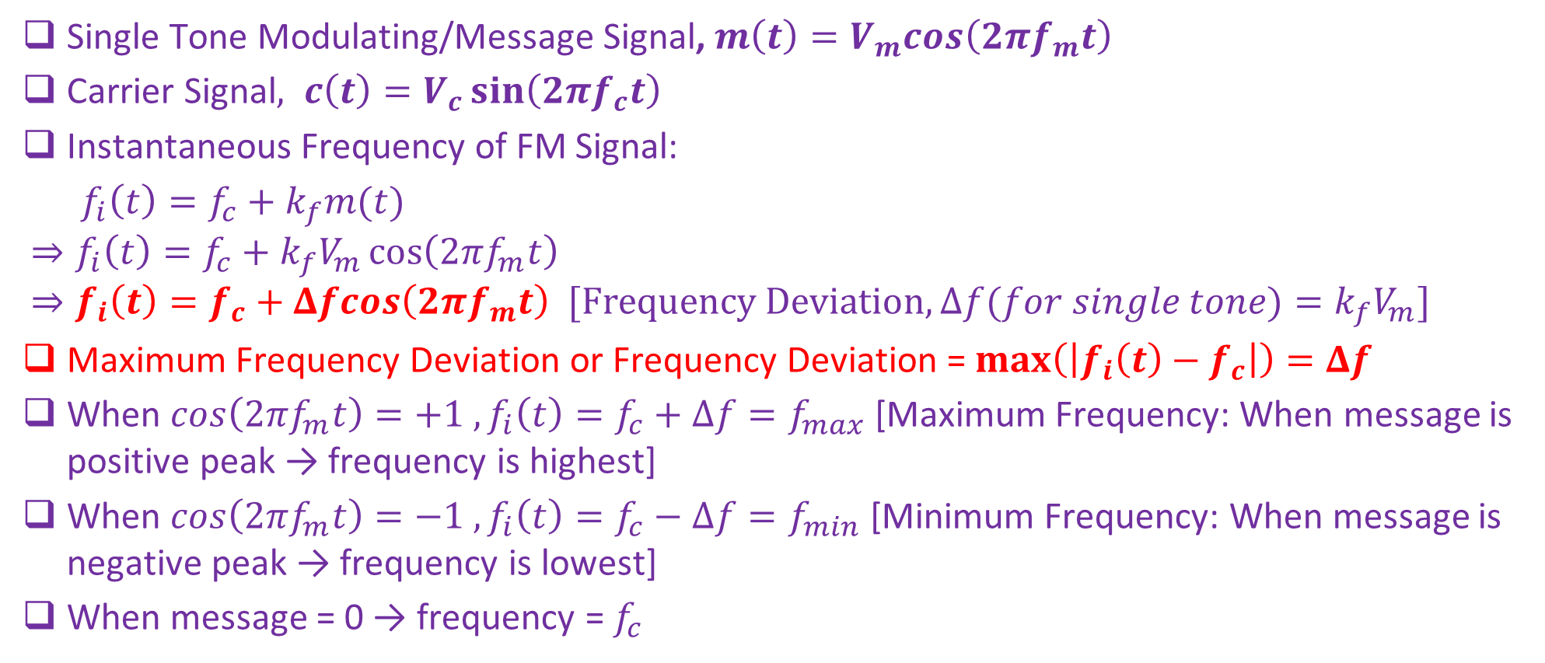
Single Tone Frequency Modulation
Single Tone Modulating/Message Signal, $m\left(t\right)=V_{m}cos\left(2πf_{m}t\right)$
Carrier Signal$, c\left(t\right)=V_{c}\sin\left(2πf_{c}t\right)$
Instantaneous Frequency of FM Signal:
$f_{i}\left(t\right)=f_{c}+k_{f}m(t)$
$$⇒f_{i}\left(t\right)=f_{c}+k_{f}V_{m}\cos\left(2πf_{m}t\right)$$
$$⇒f_{i}\left(t\right)=f_{c}+Δfcos\left(2πf_{m}t\right) [Frequency Deviation, Δf(for single tone)=k_{f}V_{m}]$$
Maximum Frequency Deviation or Frequency Deviation = $max\left(\left|f_{i}\left(t\right)−f_{c}\right|\right)=Δf$
When $cos\left(2πf_{m}t\right)=+1 , f_{i}\left(t\right)=f_{c}+Δf=f_{max}$ [Maximum Frequency: When message is positive peak → frequency is highest]
When $cos\left(2πf_{m}t\right)=−1 , f_{i}\left(t\right)=f_{c}−Δf=f_{min}$ [Minimum Frequency: When message is negative peak → frequency is lowest]
When message = 0 → frequency = $f_{c}$

Slide 3
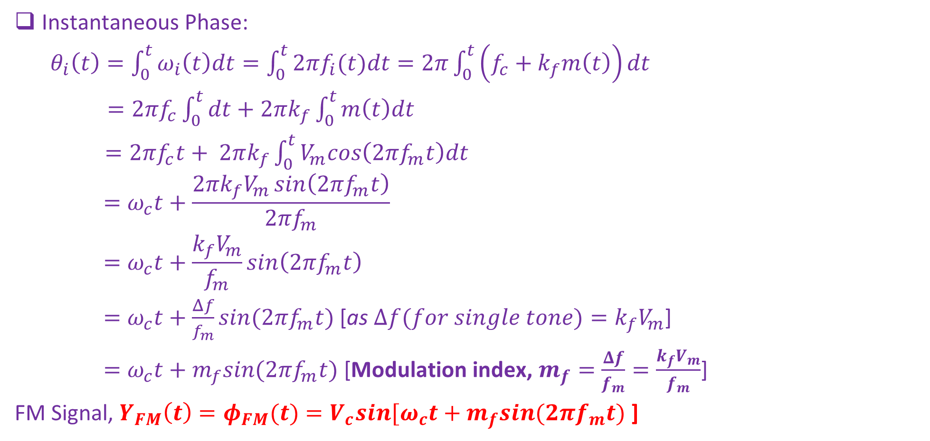
Single Tone Frequency Modulation
Instantaneous Phase:
$θ_{i}\left(t\right)=\int_{0}^{t}{ω_{i}\left(t\right)dt}=\int_{0}^{t}{2πf_{i}(t)dt}=2π\int_{0}^{t}{\left(f_{c}+k_{f}m\left(t\right)\right)dt}$
$=2πf_{c}\int_{0}^{t}{dt+2πk_{f}\int_{0}^{t}{m\left(t\right)dt}}$
$=2πf_{c}t+ 2πk_{f}\int_{0}^{t}{V_{m}cos\left(2πf_{m}t\right)dt}$
$$=ω_{c}t+\frac{2πk_{f}V_{m}\sin\left(2πf_{m}t\right)}{2πf_{m}}$$
$$=ω_{c}t+\frac{k_{f}V_{m}}{f_{m}}sin\left(2πf_{m}t\right)$$
$=ω_{c}t+\frac{Δf}{f_{m}}sin(2πf_{m}t)$ [as $Δf(for single tone)=k_{f}V_{m}$]
$=ω_{c}t+m_{f}sin(2πf_{m}t)$ [Modulation index, $m_{f}=$ $\frac{Δf}{f_{m}}=$ $\frac{k_{f}V_{m}}{f_{m}}$]
FM Signal, $Y_{FM}\left(t\right)=φ_{FM}(t)=V_{c}sin⁡[ω_{c}t+m_{f}sin(2πf_{m}t)$ ]

Slide 4
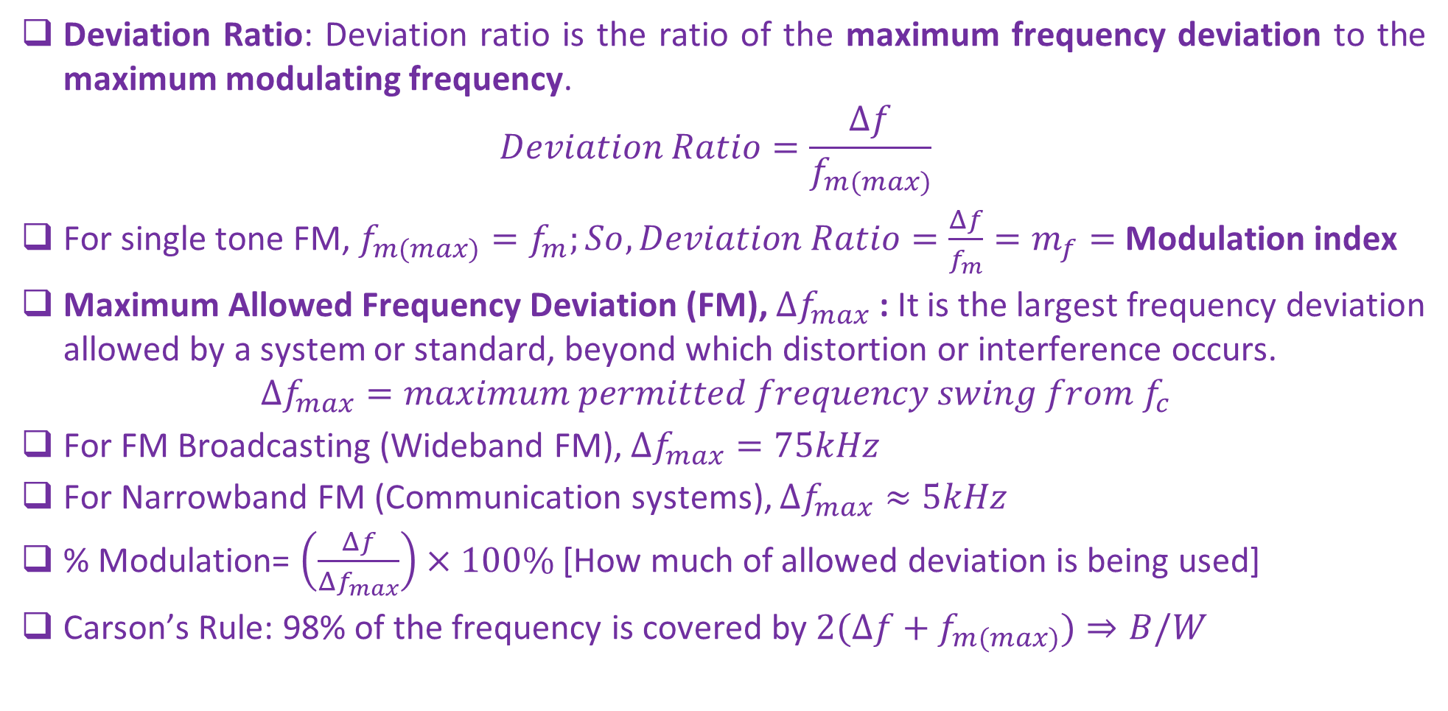
Single Tone Frequency Modulation
Deviation Ratio: Deviation ratio is the ratio of the maximum frequency deviation to the maximum modulating frequency.
$$Deviation Ratio=\frac{Δf}{f_{m(max)}}$$
For single tone FM, $f_{m(max)}=f_{m};So, Deviation Ratio=\frac{Δf}{f_{m}}=m_{f}=$Modulation index
Maximum Allowed Frequency Deviation (FM), $Δf_{max}$: It is the largest frequency deviation allowed by a system or standard, beyond which distortion or interference occurs.
$$Δf_{max}=maximum permitted frequency swing from f_{c}$$
For FM Broadcasting (Wideband FM), $Δf_{max}=75kHz$
For Narrowband FM (Communication systems), $Δf_{max}≈5kHz$
% Modulation= $\left(\frac{Δf}{{Δf}_{max}}\right)×100\%$ [How much of allowed deviation is being used]
Carson’s Rule: 98% of the frequency is covered by $2(Δf+f_{m(max)})⇒B/W$

Slide 5
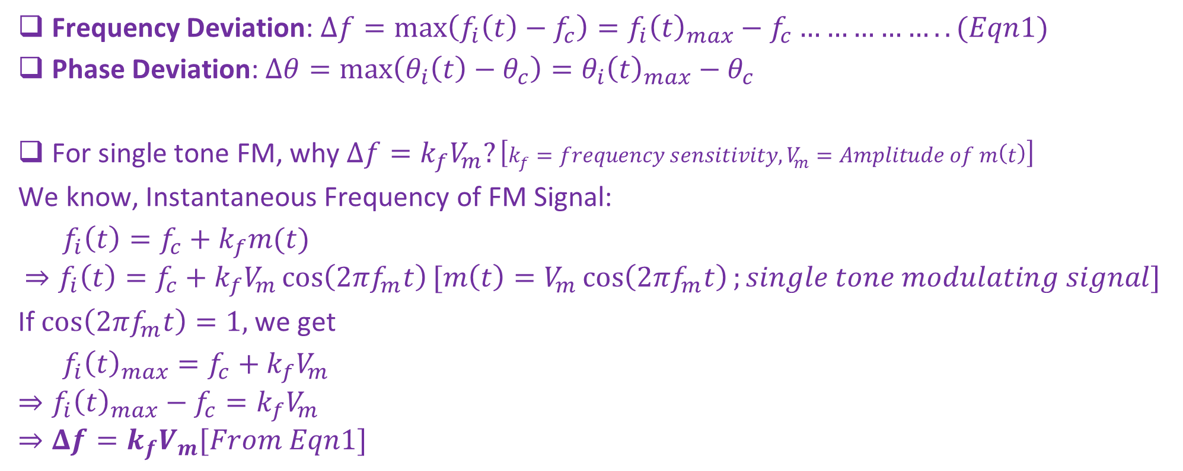
Frequency Deviation and Phase Deviation
Frequency Deviation: $Δf=\max\left(f_{i}\left(t\right)−f_{c}\right)=f_{i}{\left(t\right)}_{max}−f_{c}……………..(Eqn1)$
Phase Deviation: $Δθ=\max\left(θ_{i}\left(t\right)−θ_{c}\right)=θ_{i}{\left(t\right)}_{max}−θ_{c}$
For single tone FM, why $Δf=k_{f}V_{m}?\left[k_{f}=frequency sensitivity,V_{m}=Amplitude of m\left(t\right)\right]$
We know, Instantaneous Frequency of FM Signal:
$f_{i}\left(t\right)=f_{c}+k_{f}m(t)$
$$⇒f_{i}\left(t\right)=f_{c}+k_{f}V_{m}\cos\left(2πf_{m}t\right)[m\left(t\right)=V_{m}\cos\left(2πf_{m}t\right);single tone modulating signal]$$
If $\cos\left(2πf_{m}t\right)=1,$we get
$f_{i}{\left(t\right)}_{max}=f_{c}+k_{f}V_{m}$
$$⇒f_{i}{\left(t\right)}_{max}−f_{c}=k_{f}V_{m}$$
$$⇒Δf=k_{f}V_{m}[From Eqn1]$$

Slide 6
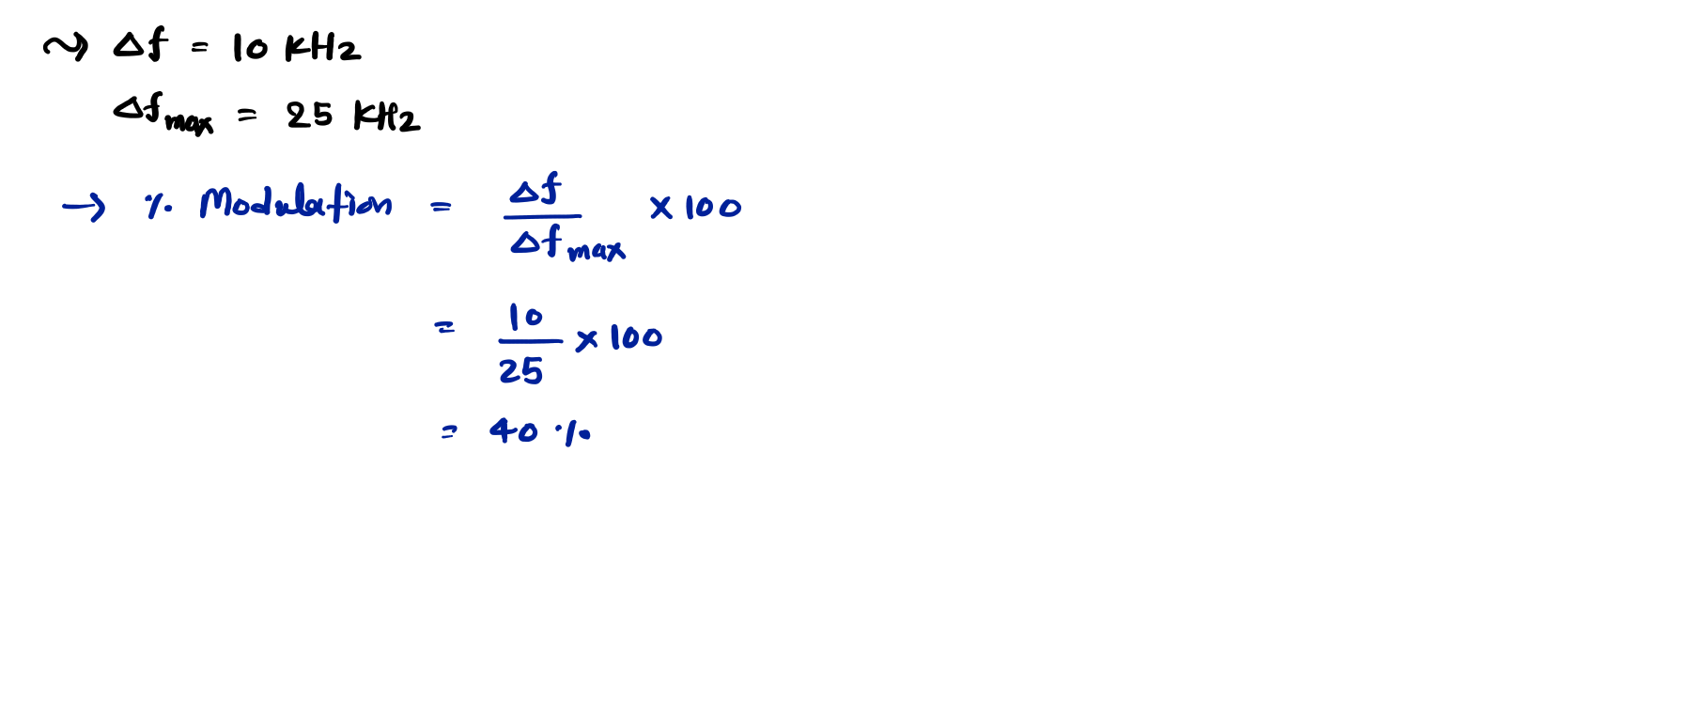
Examples of Frequency Modulation
Example 1. Determine the percentage modulation for an FM wave with a frequency deviation of 10 kHz, if the maximum deviation allowed is 25 kHz.

Slide 7
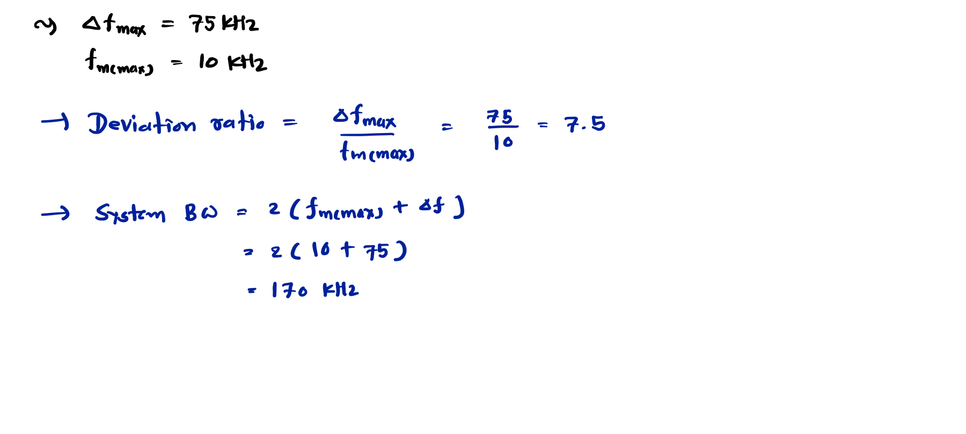
Example 2. In an FM system, if the maximum value of deviation is 75 kHz and the maximum modulating frequency is 10 kHz, calculate the deviation ratio and bandwidth of the system using the Carson rule.

Slide 8
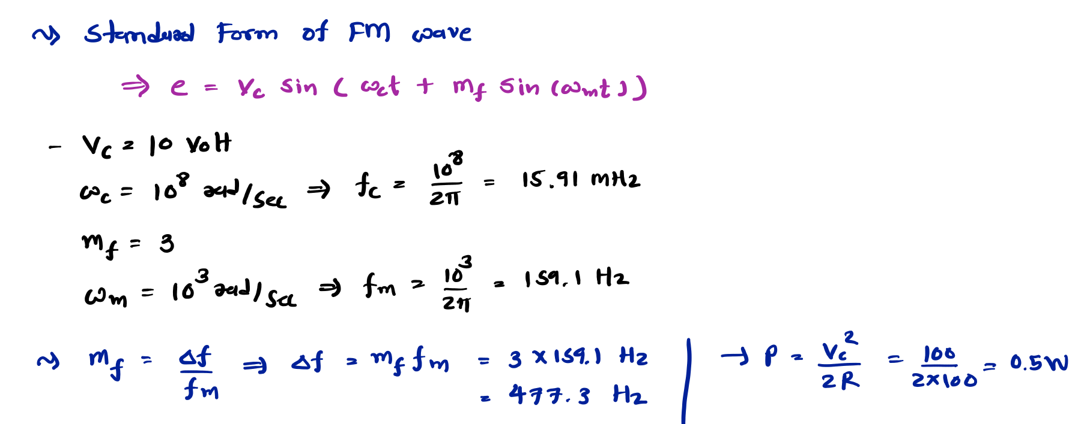
Example 3. The equation of an angle-modulated voltage is
⟹ 𝐞 = 𝟏𝟎 𝐬𝐢𝐧 𝟏𝟎^{𝟖}𝐭 + 𝟑 𝐬𝐢𝐧 𝟏𝟎^{𝟑}𝐭
What form of angle modulation is this while the message signal is a cos wave? Calculate the carrier and modulating frequencies, the modulation index and deviation and the power dissipated in 100𝛀 resistor.

Slide 9
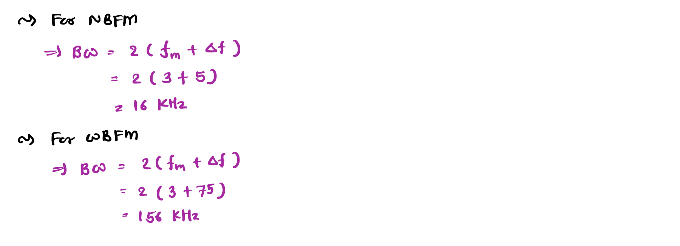
Examples of Frequency Modulation
Example 4. Use Carson’s Rule to compare the bandwidth that would be required to transmit a baseband signal with a frequency range from 300 Hz to 3 kHz using
NBFM with maximum deviation of 5 kHz.
WBFM with maximum deviation of 75 kHz.

Slide 10
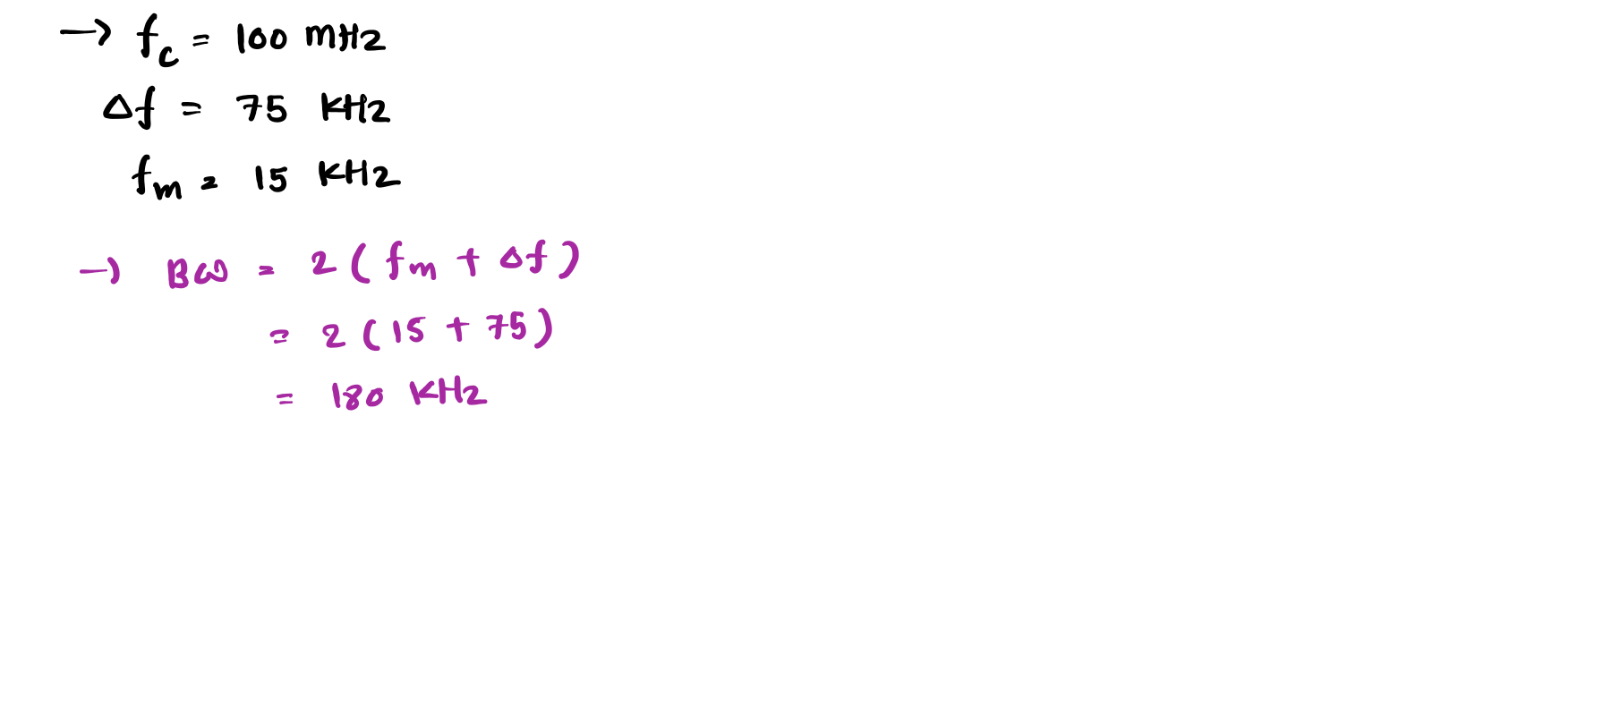
Example 5. The carrier frequency of an FM broadcast transmitter is 100 MHz, and the maximum frequency deviation is 75 kHz. If the highest audio frequency modulating carrier is 15 kHz. What is the approximate bandwidth of the signal?

Slide 11
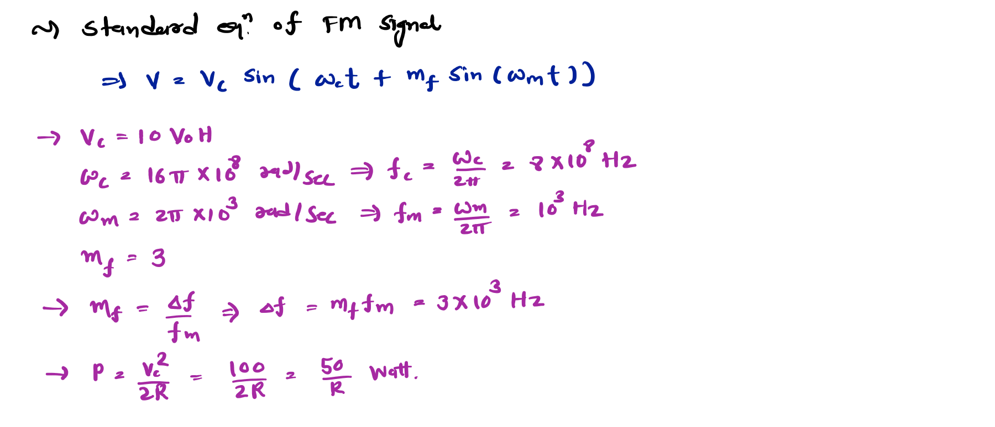
Example 6. A single tone FM signal is given by:
⟹ 𝐕 = 𝟏𝟎 𝐬𝐢𝐧 𝟏𝟔𝛑 × 𝟏𝟎^{𝟖}𝐭 + 𝟑 𝐬𝐢𝐧 𝟐𝛑 × 𝟏𝟎^{𝟑}𝐭 𝐕𝐨𝐥𝐭
Find the modulation index, modulating frequency, deviation, carrier frequency and power of the FM signal.

Slide 12
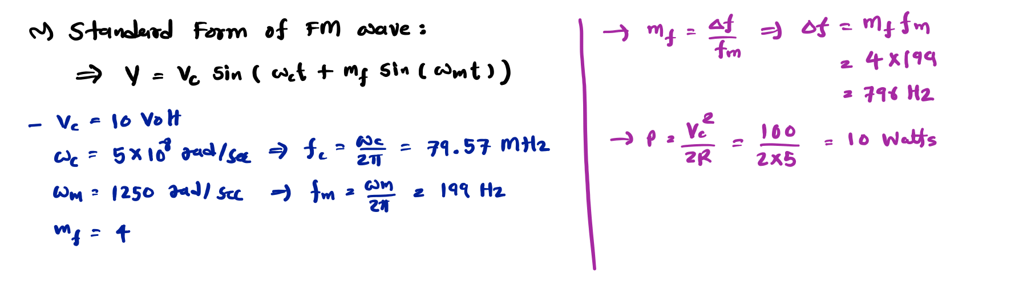
Examples of Frequency Modulation
Example 7. A FM wave is represented by the following equation:
⟹ 𝐕 = 𝟏𝟎 𝐬𝐢𝐧 𝟓 × 𝟏𝟎^{𝟖}𝐭 + 𝟒 𝐬𝐢𝐧 𝟏𝟐𝟓𝟎𝐭 𝐕𝐨𝐥𝐭
Find,
Carrier and Modulating Frequencies
Modulation Index and Maximum Deviation
The Power dissipated by this FM wave in 𝟓𝛀 resistor.

Slide 13
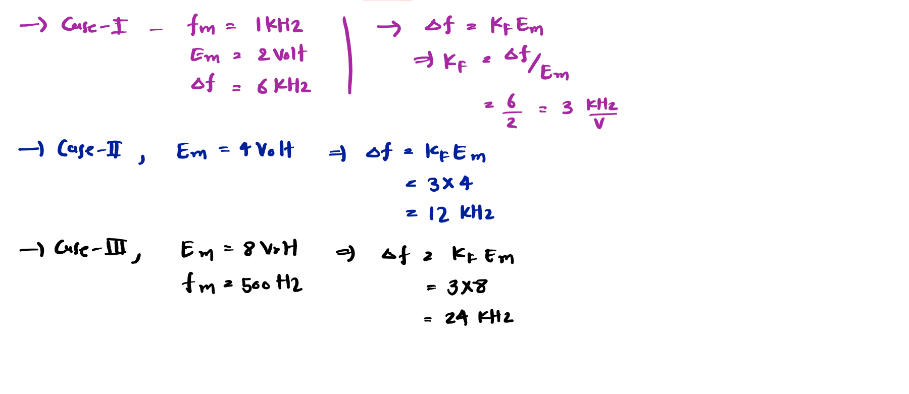
Example 8. In a FM System, the modulating frequency 𝐟_{𝐦} = 𝟏 𝐤𝐇𝐳, the modulating voltage
𝐄_{𝐦} = 𝟐 𝐯𝐨𝐥𝐭 and the deviation is 6 kHz. If the modulating voltage is raised to 4 volt then what is the new deviation? If the modulating voltage is further increased to 8 volt and modulating frequency is reduced to 500 Hz what will be deviation?

Slide 14
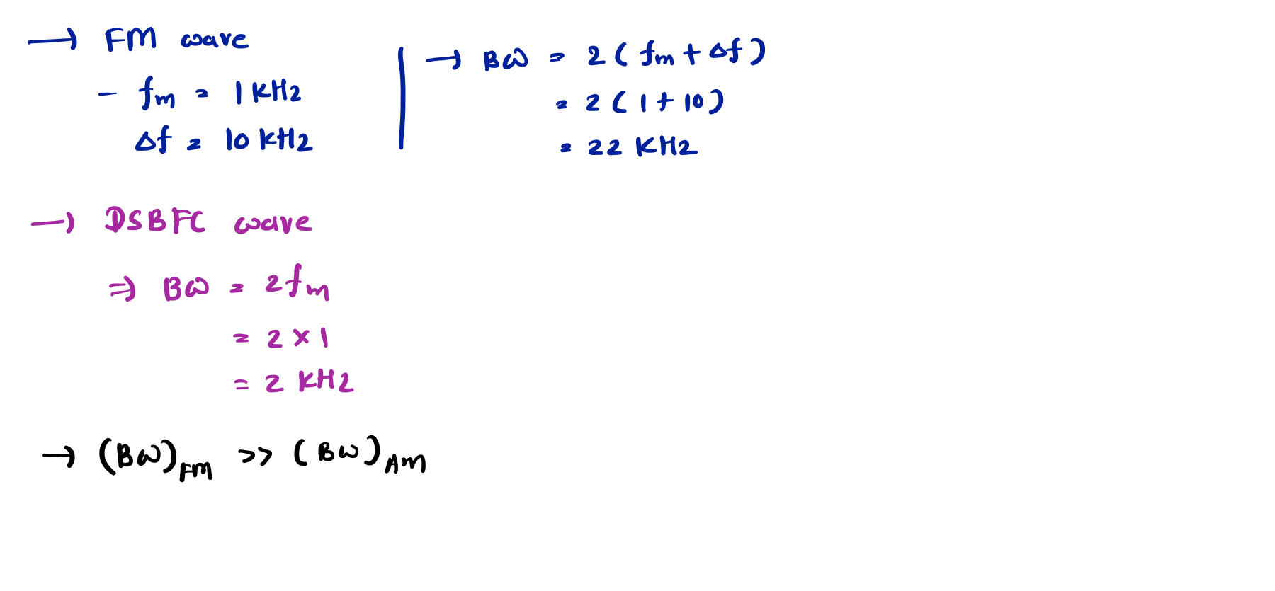
Example 9. What is the bandwidth required for an FM signal if the modulating frequency is 1kHz and the maximum deviation is 10kHz? What is the BW required for a DSBFC (AM) transmission?

Slide 15
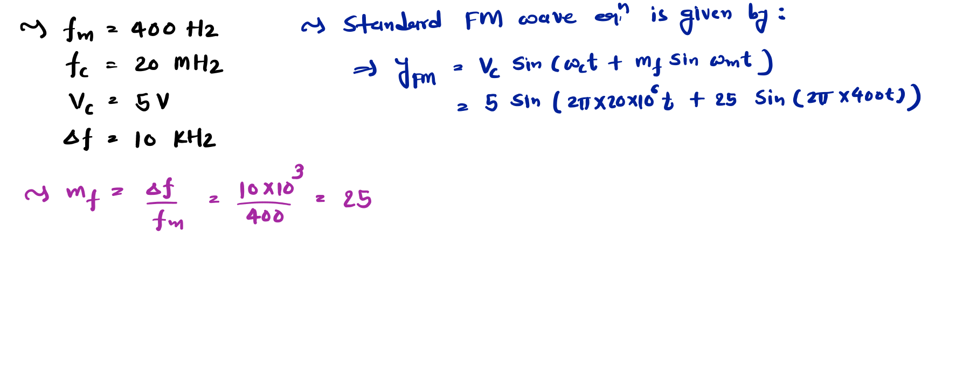
Examples of Frequency Modulation
Example 10. A 400 Hz modulating signal modulates a 20 MHz carrier. The carrier voltage is 5V, and the maximum deviation is 10 kHz. Write down the mathematical expression for the FM wave considering the carrier and message signal as sin and cos wave respectively.

Slide 16
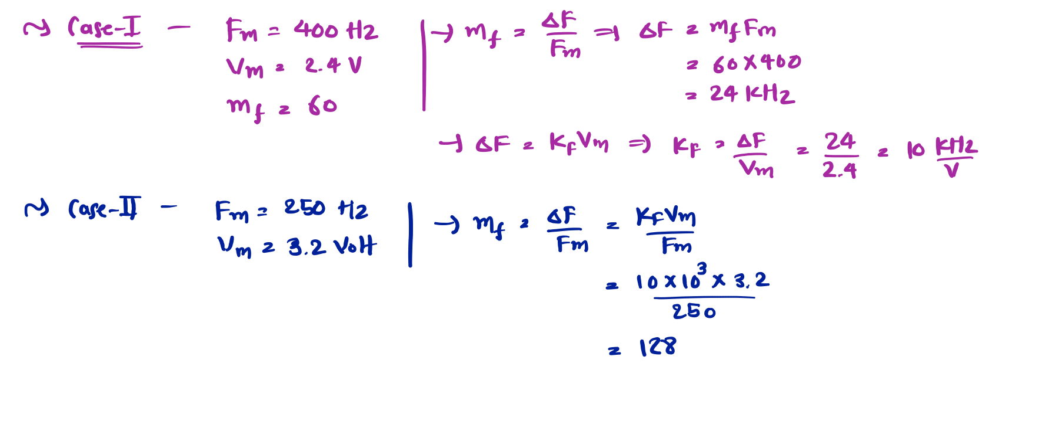
Example 11. When the modulating frequency in an FM system is 400 Hz and the modulating voltage is 2.4V, the modulating index is 60. Calculate the maximum deviation. What is the modulation index when the modulating frequency is reduced to 250 Hz and the modulating voltage is simultaneously raised to 3.2V?

Slide 17
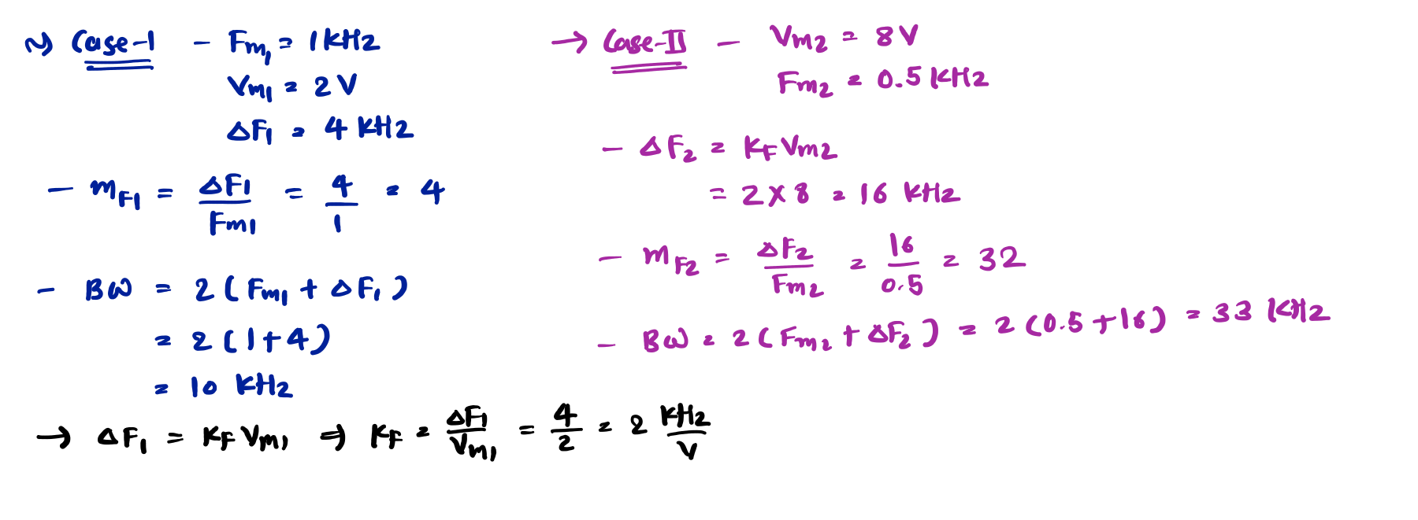
Examples of Frequency Modulation
Example 12. In an FM system, the audio frequency is 1 kHz, and the audio voltage is 2 volts. The deviation is 4 kHz. If the AF voltage is now increased to 8 volts, and its frequency dropped to 500 Hz. Find the modulating index in each case and the corresponding bandwidth using Carson’s rule.

Slide 18
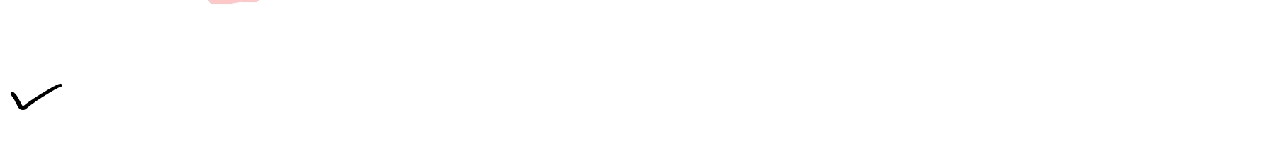
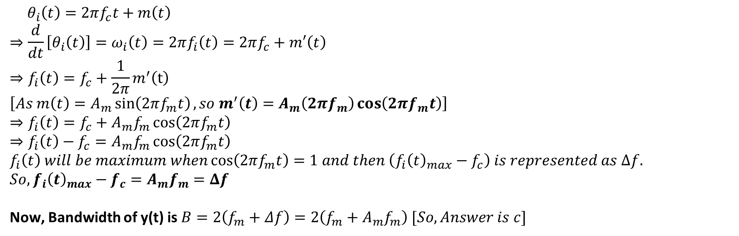
Example 13. A message signal 𝐦 𝐭 carrier 𝐀_{𝐂} 𝐬𝐢𝐧 𝟐𝛑𝐟_{𝐂}𝐭 to get the bandwidth of 𝐲 𝐭 .
= 𝐀_{𝐦} 𝐬𝐢𝐧 𝟐𝛑𝐟_{𝐦}𝐭
modulated signal
is used to modulate the phase of a
𝐲 𝐭 = 𝐀_{𝐂} 𝐬𝐢𝐧 𝟐𝛑𝐟_{𝐂}𝐭 + 𝐦 𝐭 . The
Depends on 𝐀_{𝐦} but not on 𝐟_{𝐦}
Depends on 𝐟_{𝐦} but not on 𝐀_{𝐦}
Depends on both 𝐀_{𝐦} and 𝐟_{𝐦}
Does not Depends on 𝐀_{𝐦} and 𝐟_{𝐦}
$${ θ}_{i}\left(t\right)=2πf_{c}t+m\left(t\right)$$
$$⇒\frac{d}{dt}\left[θ_{i}\left(t\right)\right]=ω_{i}\left(t\right)=2πf_{i}\left(t\right)=2πf_{c}+m′\left(t\right)$$
$$⇒f_{i}\left(t\right)=f_{c}+\frac{1}{2π}m^{′}\left(t\right)$$
$$\left[As m\left(t\right)=A_{m}\sin\left(2πf_{m}t\right), so m^{′}\left(t\right)=A_{m}\left(2πf_{m}\right)\cos\left(2πf_{m}t\right)\right]$$
$$⇒f_{i}\left(t\right)=f_{c}+A_{m}f_{m}\cos\left(2πf_{m}t\right)$$
$$⇒f_{i}\left(t\right)−f_{c}=A_{m}f_{m}\cos\left(2πf_{m}t\right)$$
$$f_{i}\left(t\right) will be maximum when\cos\left(2πf_{m}t\right)=1 and then \left(f_{i}{\left(t\right)}_{max}−f_{c}\right) is represented as Δf.$$
$$So, f_{i}{\left(t\right)}_{max}−f_{c}=A_{m}f_{m}=Δf$$
Now, Bandwidth of y(t) is $B=2\left(f_{m}+Δf\right)=2\left(f_{m}+A_{m}f_{m}\right) [So, Answer is c]$

Slide 19
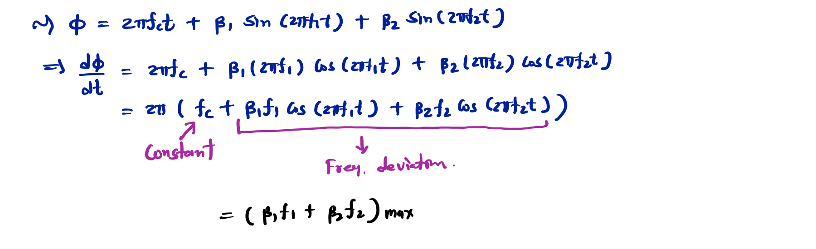
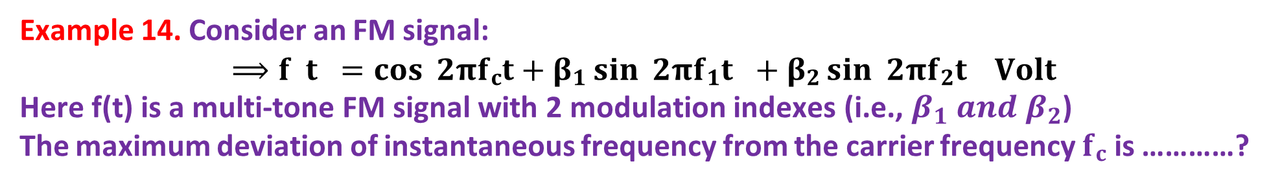
Example 14. Consider an FM signal:
⟹ 𝐟 𝐭 = 𝐜𝐨𝐬 𝟐𝛑𝐟_{𝐜}𝐭 + 𝛃_{𝟏} 𝐬𝐢𝐧 𝟐𝛑𝐟_{𝟏}𝐭 + 𝛃_{𝟐} 𝐬𝐢𝐧 𝟐𝛑𝐟_{𝟐}𝐭 𝐕𝐨𝐥𝐭
Here f(t) is a multi-tone FM signal with 2 modulation indexes (i.e., $β_{1} and β_{2}$)
The maximum deviation of instantaneous frequency from the carrier frequency 𝐟_{𝐜} is …………?

Slide 20
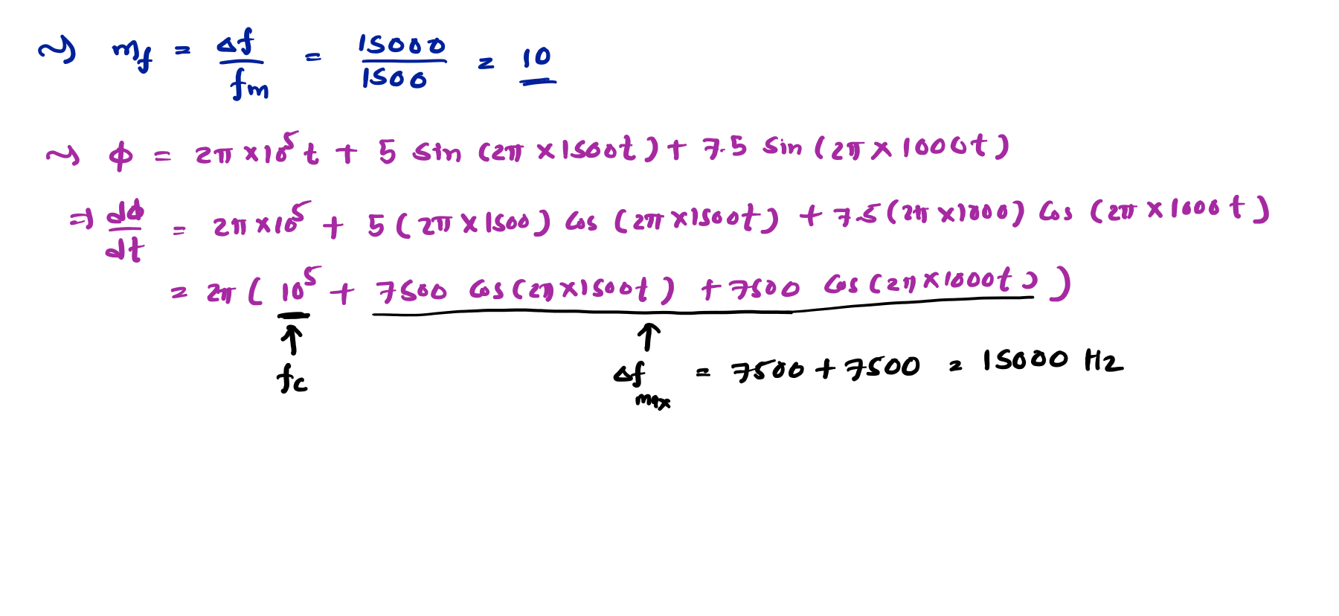

Example 15. Consider an FM signal:
⟹ 𝐟 𝐭 = 𝟏𝟎 𝐜𝐨𝐬 𝟐𝛑 × 𝟏𝟎^{𝟓}𝐭 + 𝟓 𝐬𝐢𝐧 𝟐𝛑 × 𝟏𝟓𝟎𝟎𝐭 + 𝟕. 𝟓 𝐬𝐢𝐧 𝟐𝛑 × 𝟏𝟎𝟎𝟎𝐭
The deviation ratio of given FM signal is ………………………
𝐕𝐨𝐥𝐭
Deviation Ratio = $\frac{Δf}{f_{m(max)}}=\frac{15000}{1500}=10$

Slide 21
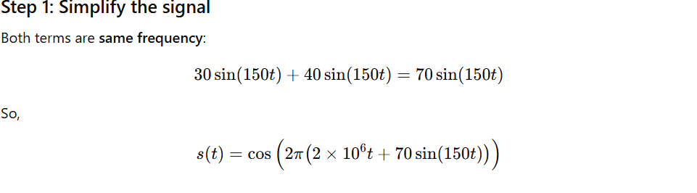

Example 16. An angle modulated signal is given by:
⟹ 𝐬 𝐭 = 𝐜𝐨𝐬 𝟐𝛑 𝟐 × 𝟏𝟎^{𝟔}𝐭 + 𝟑𝟎 𝐬𝐢𝐧 𝟏𝟓𝟎𝐭 + 𝟒𝟎 𝐬𝐢𝐧 𝟏𝟓𝟎𝐭 𝐕𝐨𝐥𝐭
The maximum frequency deviation and phase deviation of above signal are ……………?

Slide 22
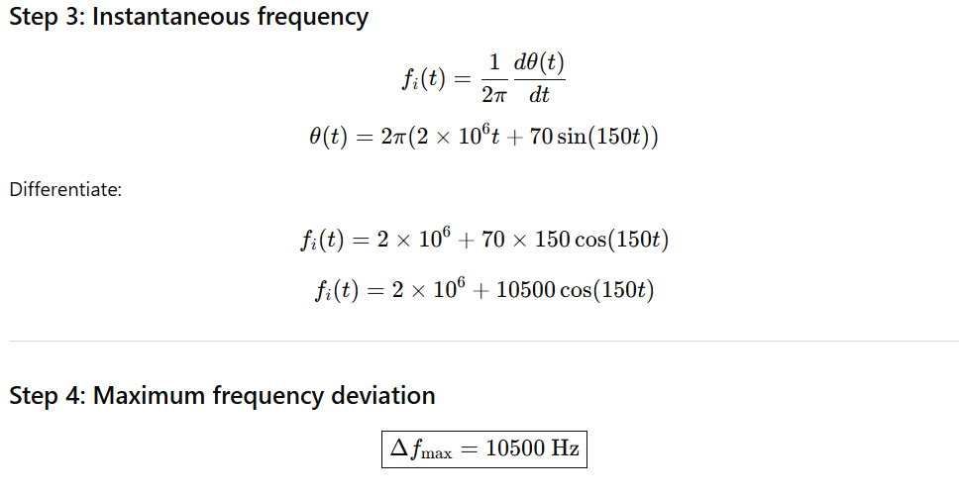

Slide 23
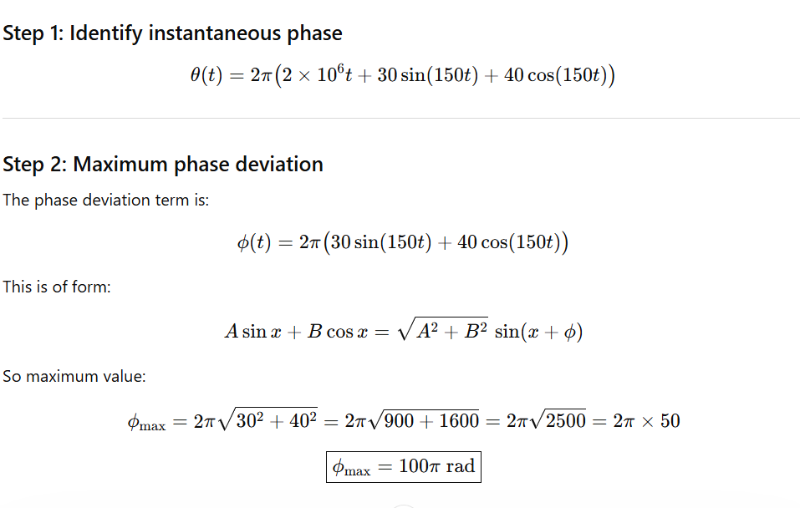
Example 17. An angle modulated signal is given by:
⟹ 𝐬 𝐭 = 𝐜𝐨𝐬 𝟐𝛑 𝟐 × 𝟏𝟎^{𝟔}𝐭 + 𝟑𝟎 𝐬𝐢𝐧 𝟏𝟓𝟎𝐭 + 𝟒𝟎 c os 𝟏𝟓𝟎𝐭 𝐕𝐨𝐥𝐭
The maximum frequency deviation and phase deviation of above signal are …………………….

Slide 24
